Slide 1

Ethnicity Detection Model

Slide 2
Introduction!
What does our project entail?
Our project is all about creating a clever computer program that can predict a person's region or race by simply looking at and analyzing their picture.

Slide 3
Problem Statement
1
Let’s start with the problem statement of our project.

Slide 4

Problem Statement
In today's connected world, figuring out where someone is from based on their looks, like their face, is tricky. This project tries to solve that by using Artificial Intelligence (AI). The goal is to look at facial features in pictures and make educated guesses about the person's likely country or region. It's a way of using technology to understand more about people from their photos.
Areas where this model may be useful:
Social Science Research
Health Care Analysis

Slide 5
Dataset
2
What’s the dataset we use..

Slide 6
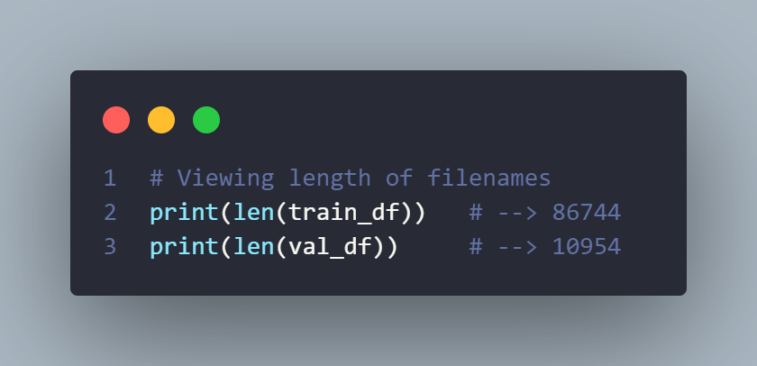
Exploratory Data Analysis
Dataset
FairFace
Train & Validation Dataset Size

Slide 7
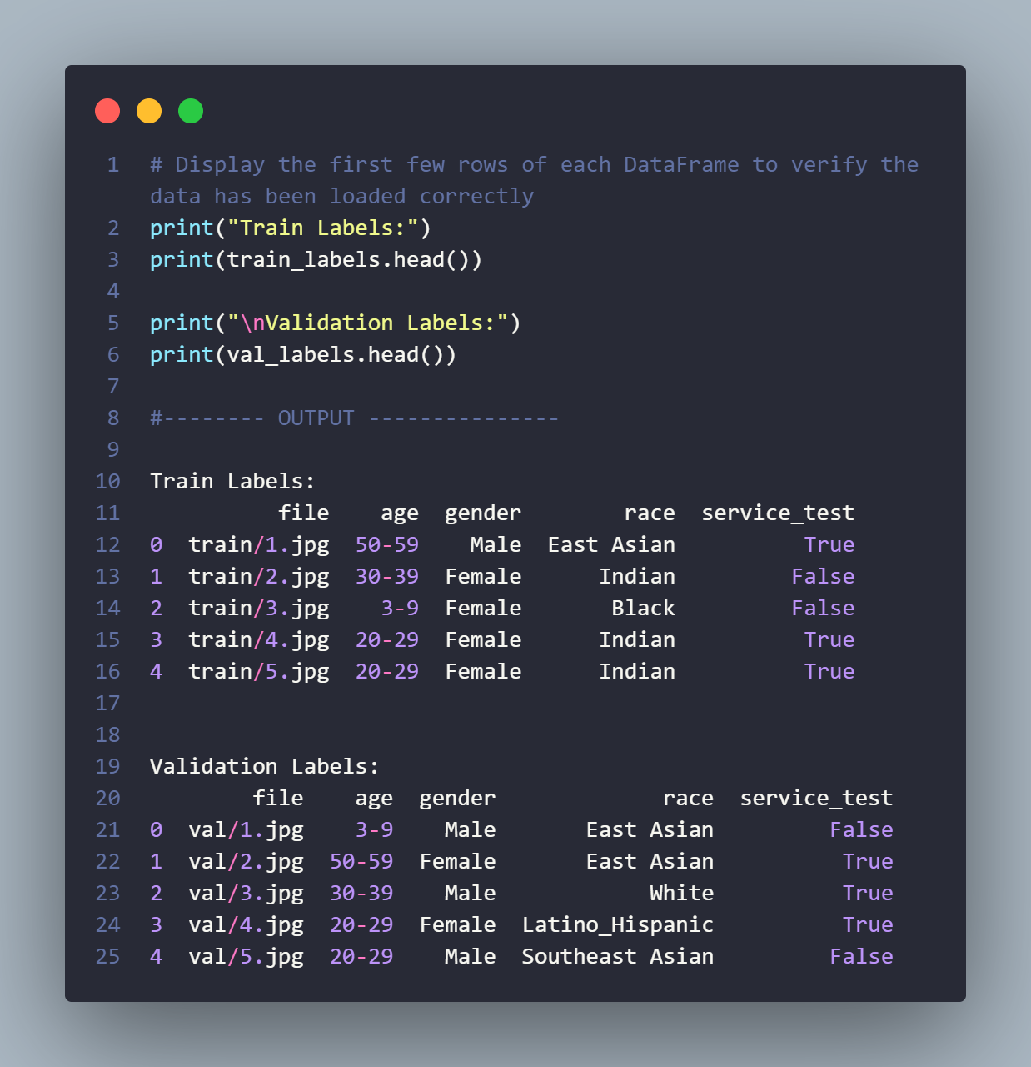
Exploratory Data Analysis
Features of Train & Validation Dataset

Slide 8
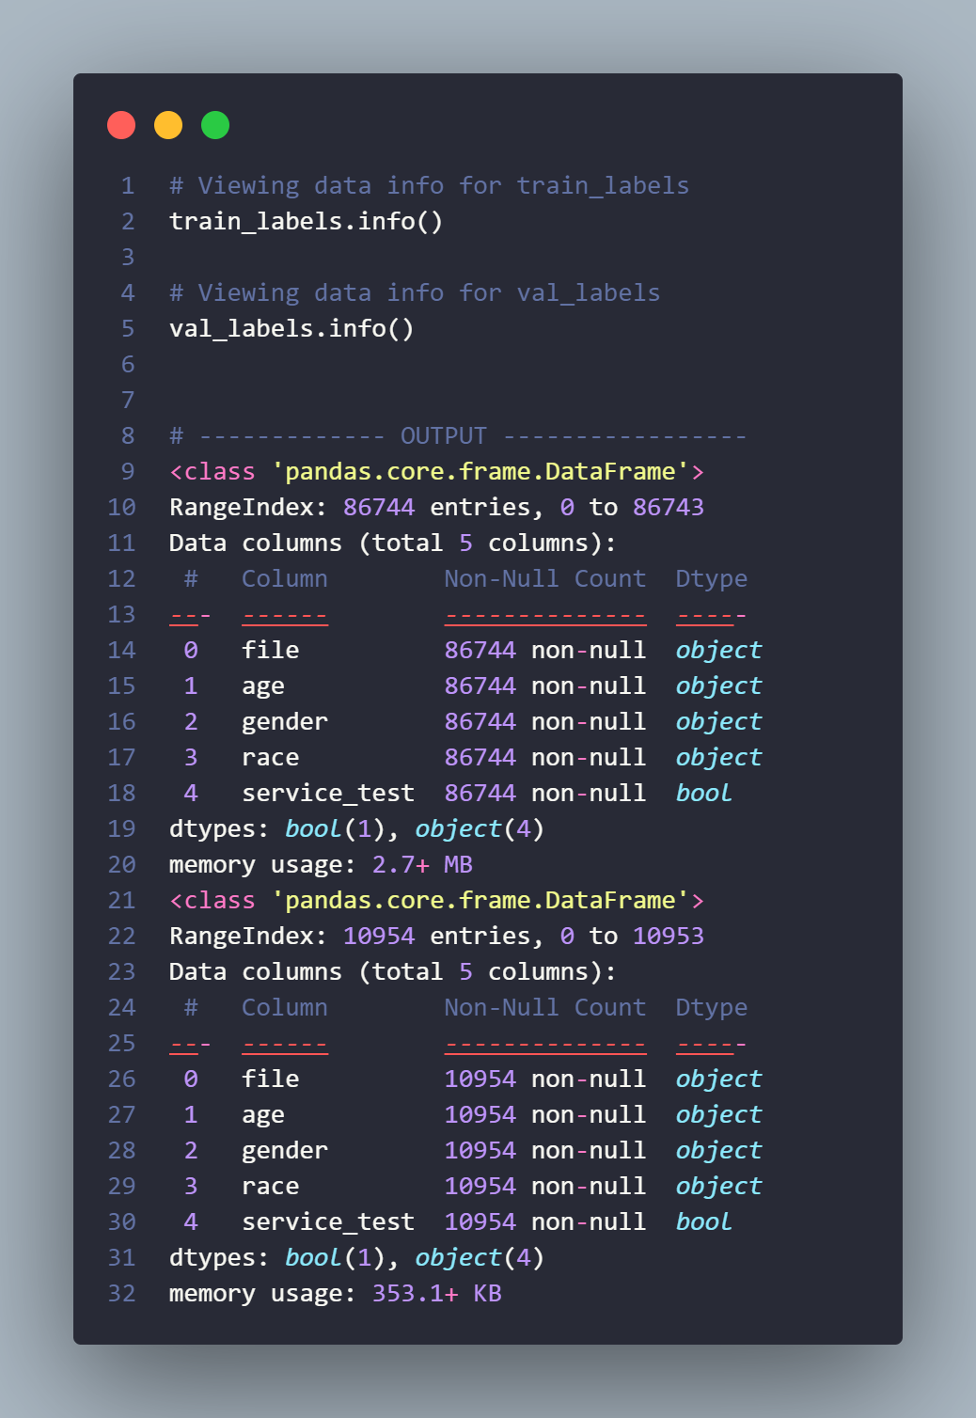
Exploratory Data Analysis
Data Information of Train & Validation Dataset

Slide 9
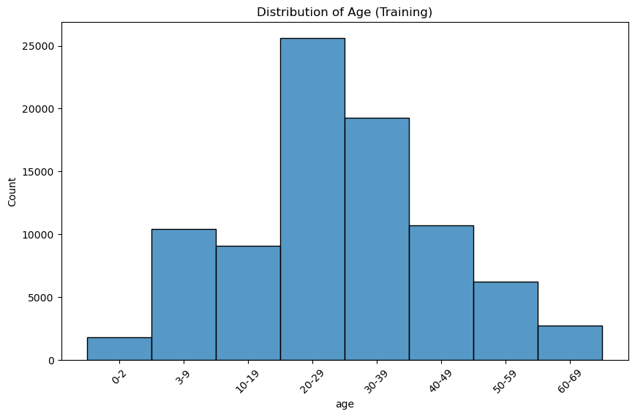
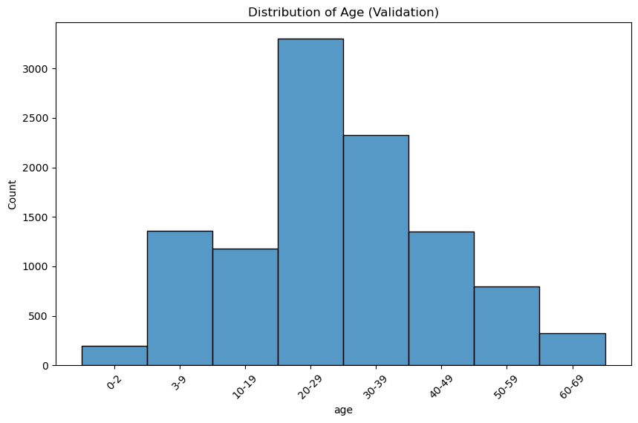
Data Visualization
Age Distribution Analysis for Training and Validation Dataset

Slide 10
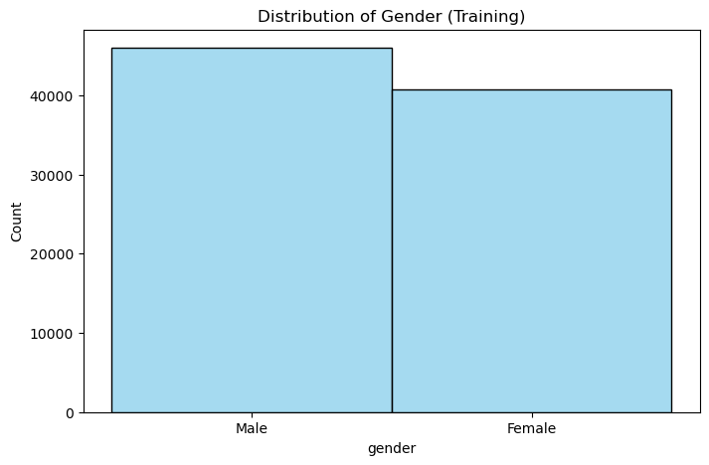
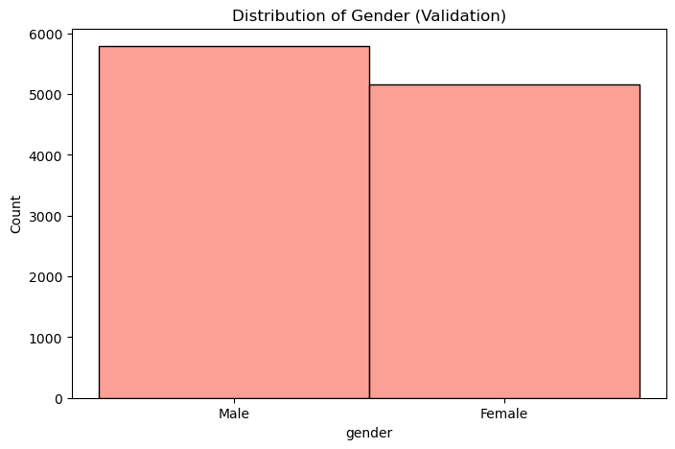
Data Visualization
Gender Distribution in Training and Validation Dataset

Slide 11
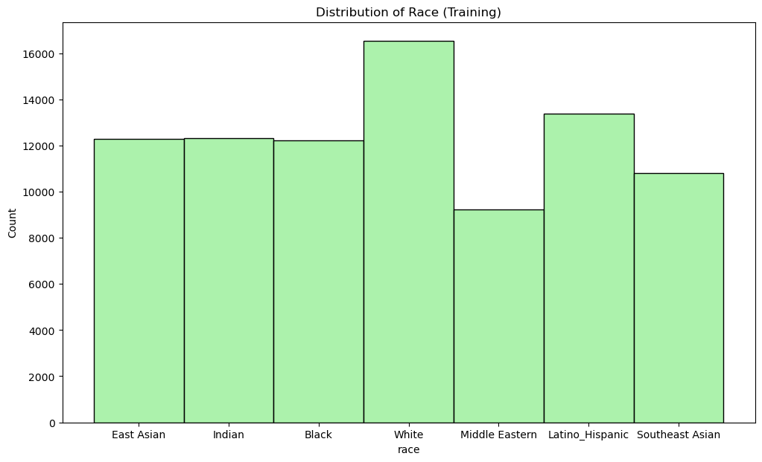
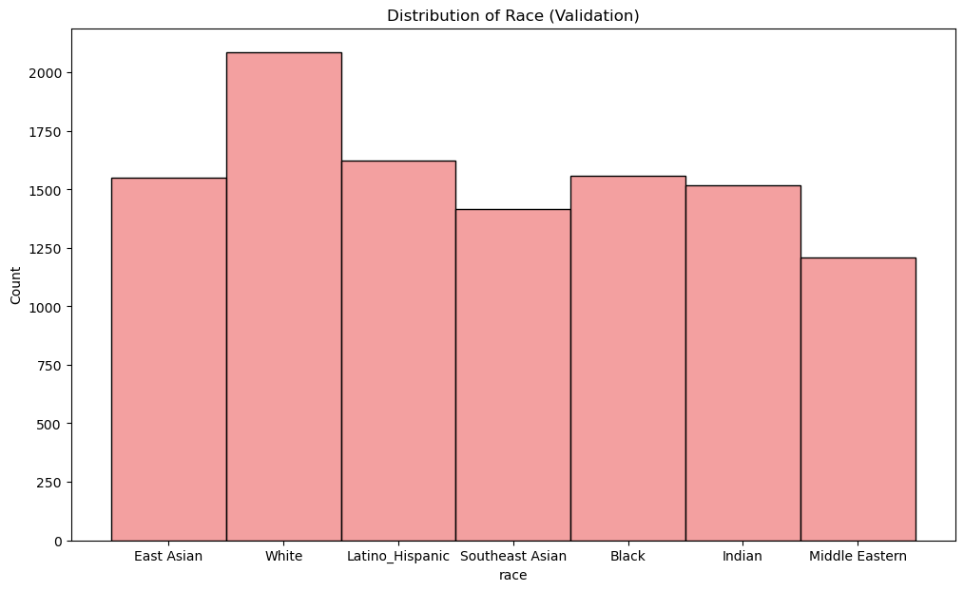
Data Visualization
Race Distribution in Training and Validation Dataset

Slide 12
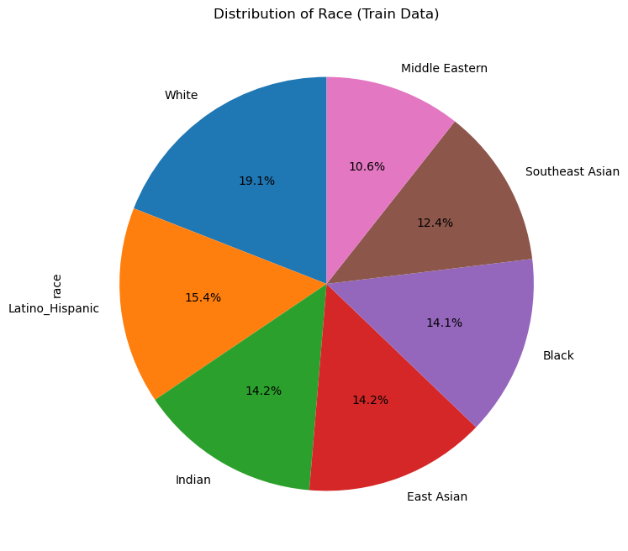
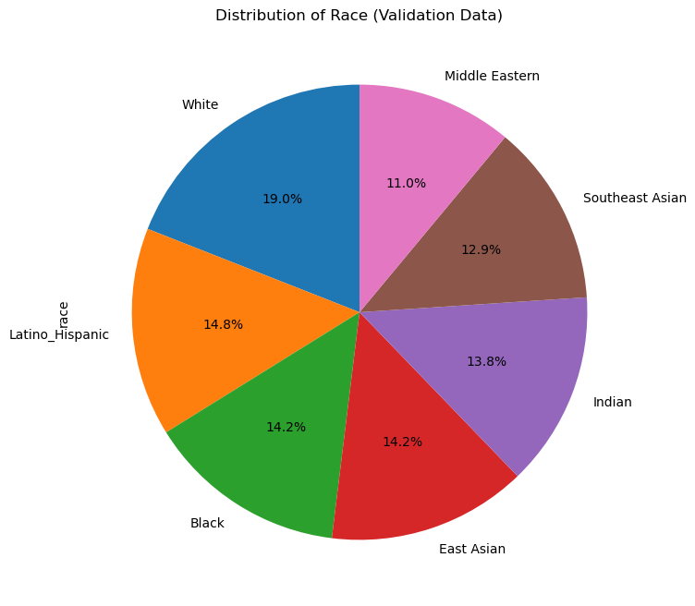
Data Visualization
Race Distribution in Training and Validation Dataset (Pie Chart)

Slide 13
Implementation & Result
3
Let’s talk about the implementations & results.

Slide 14
Implementation & Results
2
1
Language & Libraries
Algorithm
4
3
Evaluation
Outcome

Slide 15
Language & Libraries
1
For our project, we used Python, a common language for teaching computers.
We used these libraries in our project.
Libraries Numpy Pandas Tensorflow Keras Sklearn Matplotlib

Slide 16
Algorithm
2
Steps:
Used FairFace Dataset.
Pre-Processed the Dataset.
Data loading
Image Resizing
Normalization
Dataset Split
80% training data
10% test data
10% validation data
Training model

Slide 17
Algorithm
2
Steps:
Visual Geometry Group(VGG) Model Implementation
Test and Evaluate Model.
Prediction
Within the dataset
Outside the dataset

Slide 18
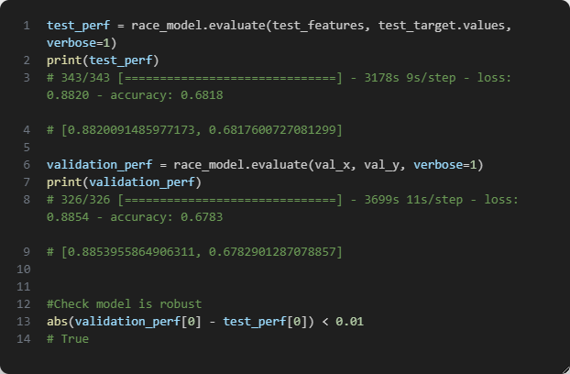
Evaluation
3

Slide 19
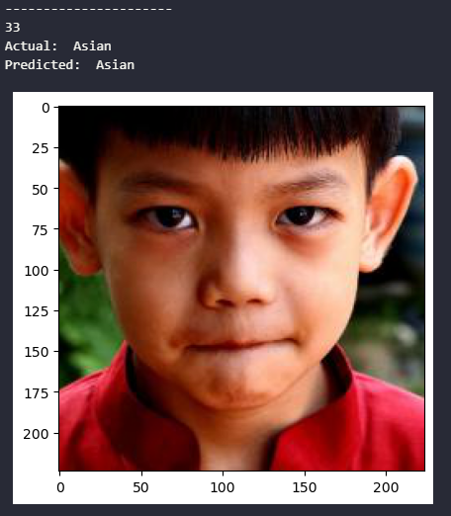
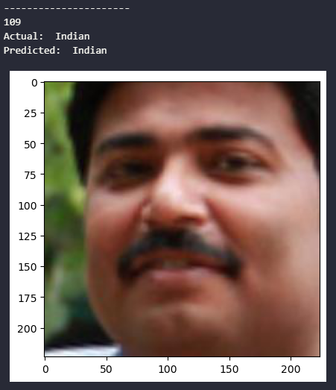
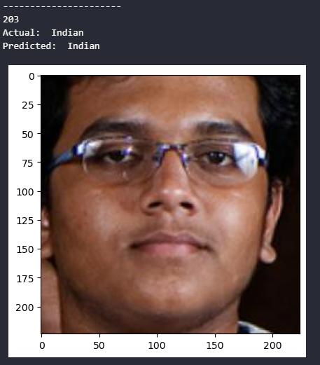
Outcome
4
Predictions for images from the dataset

Slide 20
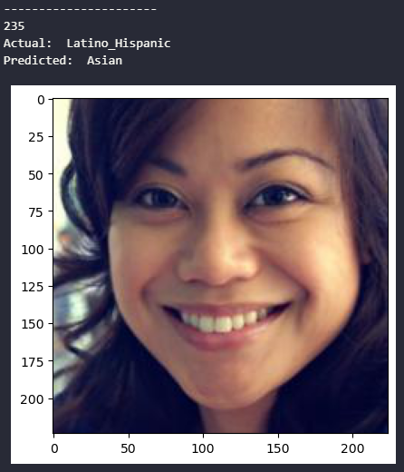
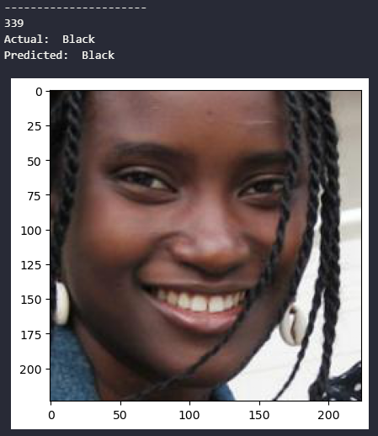
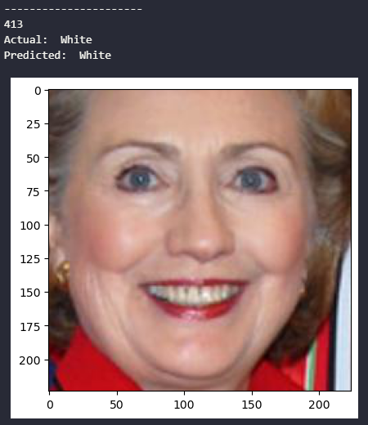
Outcome
4
Predictions for images from the dataset

Slide 21
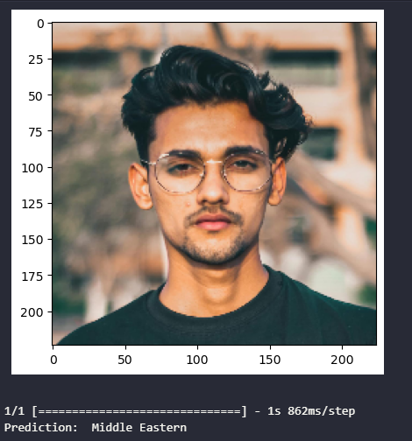
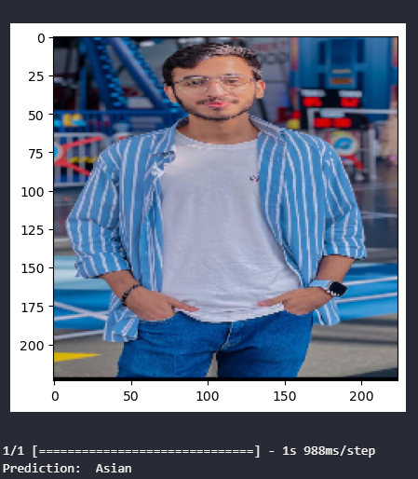
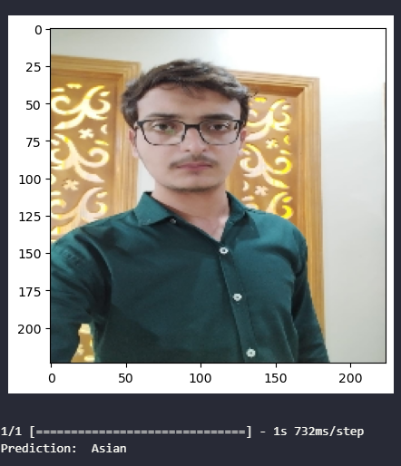
Outcome
4
Predictions for images from outside the dataset

Slide 22
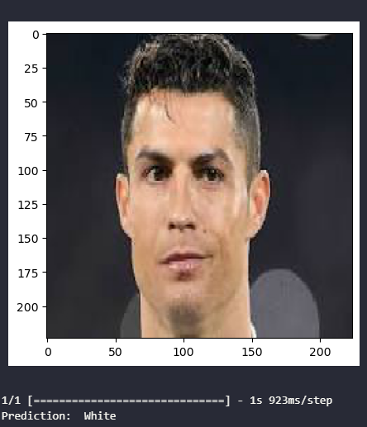
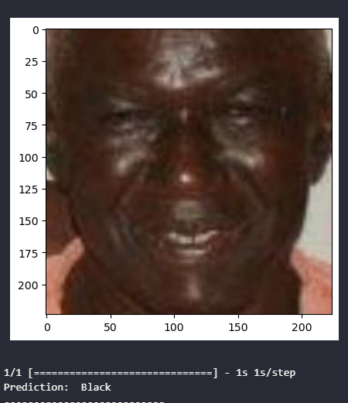
Outcome
4
Predictions for images from outside the dataset

Slide 23
Model
4
Let’s talk about the working of model.

Slide 24
Model
Visual Geometry Group (VGG ) Face Model Architecture
Structure of the Model (WORKING):
Input Layer (RGB)
Convolutional Blocks: Consist of two or more convolutional layers each capture different level of abstraction & complexity.
ReLU activation (Function)
Max Pooling
Fully Connected Layer & Dropout
Output Layer

Slide 25
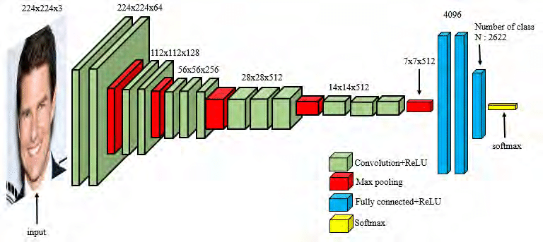
Model
VGG (Visual Geometry Group) Face Model Architecture

Slide 26
Conclusion
5
Let’s conclude this.

Slide 27
Conclusion
The Ethnicity prediction model successfully utilizes artificial intelligence to predict a person’s likely ethnicity based on facial features, offering the valuable tool for understanding and interpreting geographical backgrounds

Slide 28
Future Direction
6
Let’s talk about the future direction.

Slide 29
Future Direction
Identification of potential areas for improvement or expansion.
Exploration of additional techniques or models to enhance face recognition accuracy.
Consideration of ethical considerations and privacy concerns in future developments

Slide 30
Thanks!

